Slide 1

Telecom Customer Churn Analysis
Data-Driven Insights & Retention Strategies

Slide 2
Overview
To identify the primary factors for customer attrition and give the recommendation for business improvements
Data Sets
The dataset used for this analysis contains 7,043 rows (representing individual customers) and 21 columns (representing their attributes).
The dataset have below set of information
Demographic Information
Services Subscribed
Account & Financial Information
Tech Stack
Language: Python
Libraries:
Pandas (Data Wrangling)
Matplotlib/Seaborn (Visualization)

Slide 3
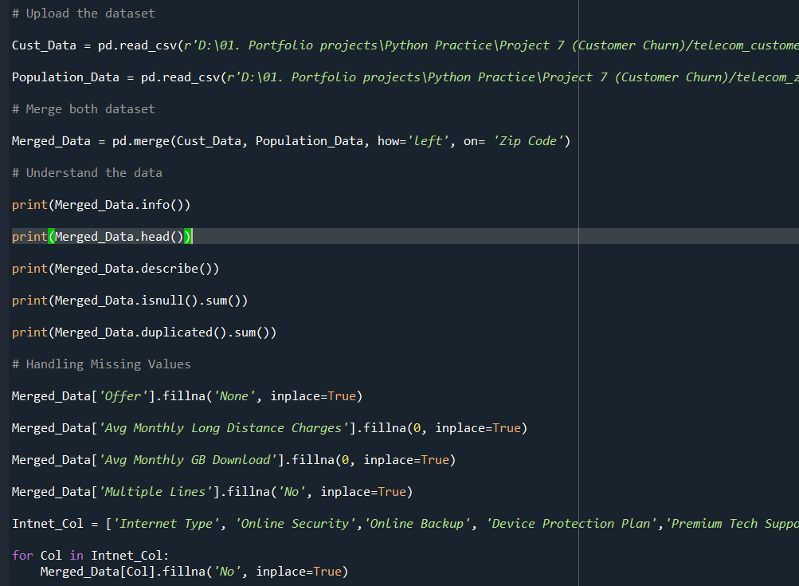
Data Wrangling
Before we deep dive into analysis, need to cleanup the data and crosschecks the data quality
Data Integration
Handling Missing Values
Duplicate checking

Slide 4
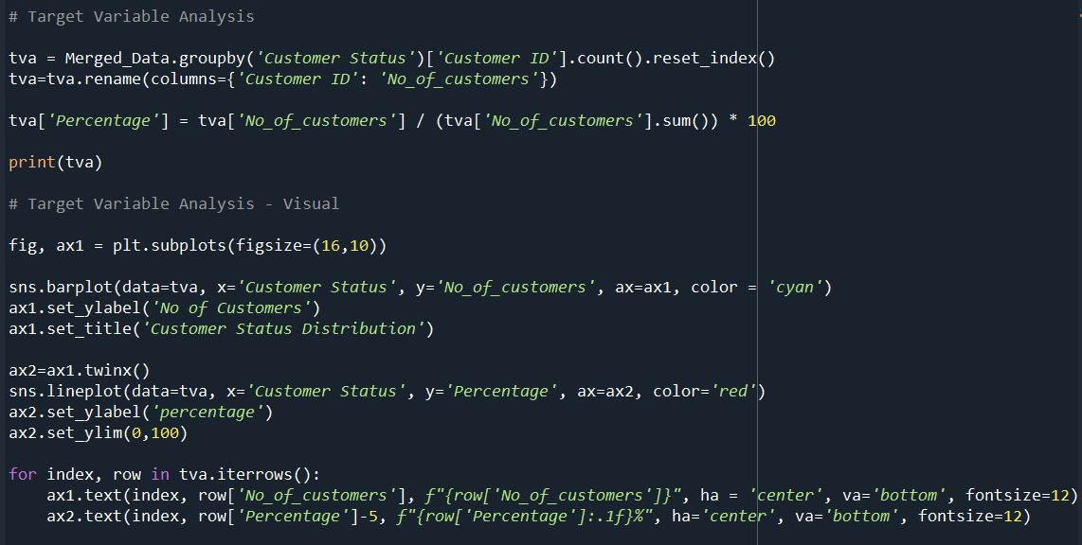
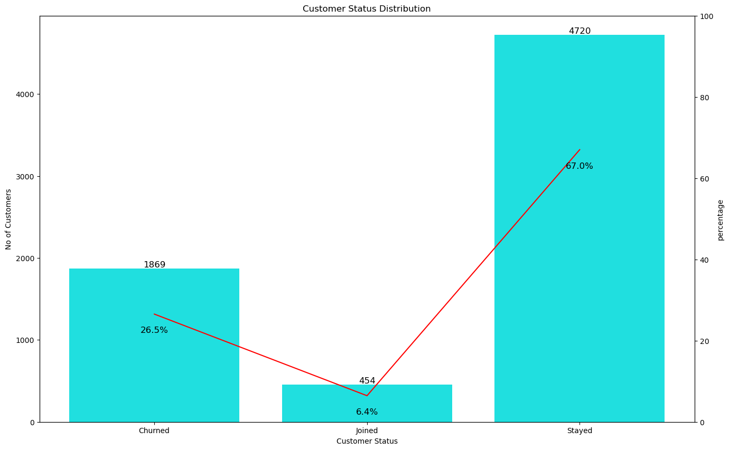
Overall Churn Snapshot
This is our target variable analysis. Its shows where are at the moment of customer retention
The data was grouped based on the customer status (churned stayed, joined)

Slide 5
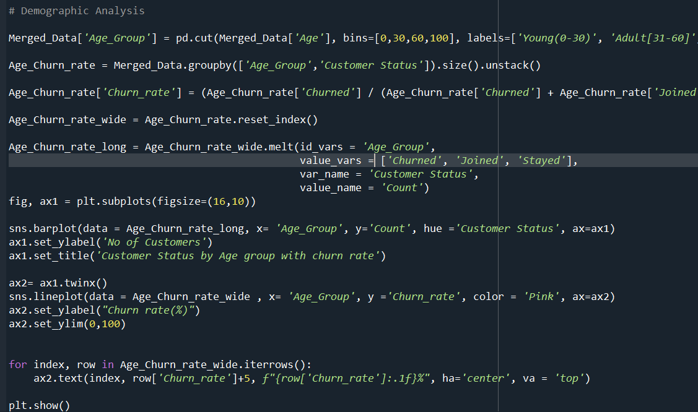
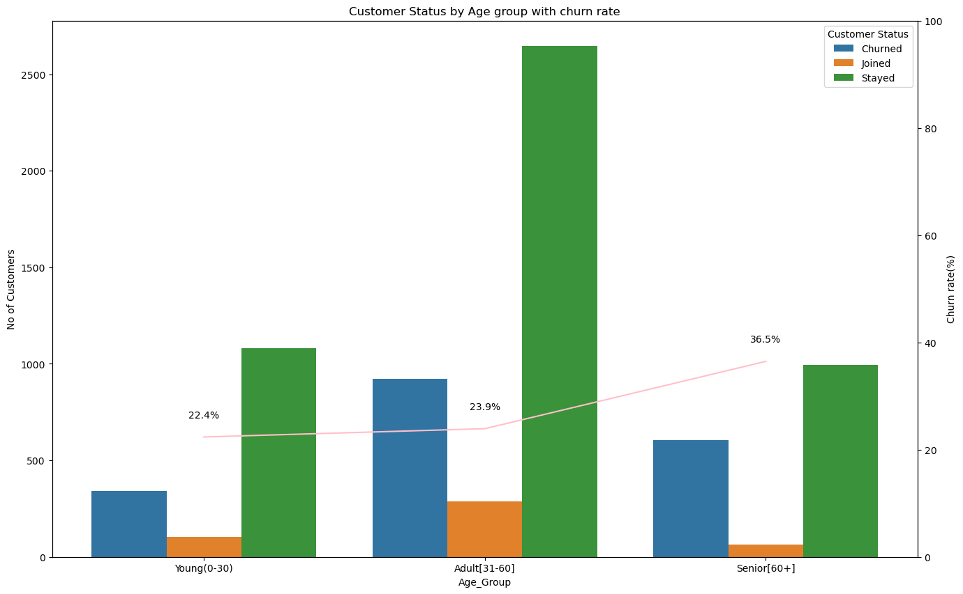
Demographic Analysis
Customers divided into three different age groups (Young, Adult, and Senior) using pd.cut
Churn rate was calculated based on the group and 36.5% of senior customers was discontinued

Slide 6
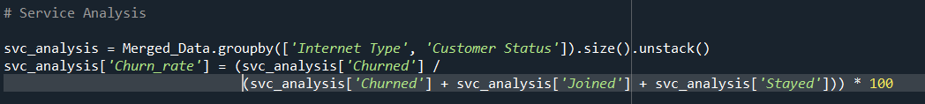
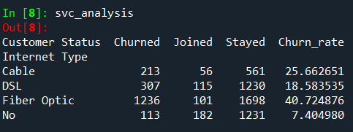
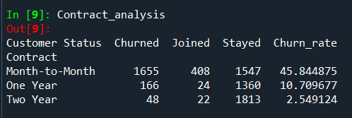
Service Analysis
We did two different analysis based on service.
Internet type(cable, DSL, or fiber option
Contract analysis(monthly, one year and two year)
Fiber Optic has an unexpectedly high churn rate of 40.7%, compared to DSL at 18.5%.
Month-to-Month contracts experience massive churn (45.8%)

Slide 7
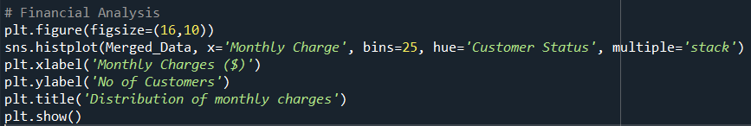
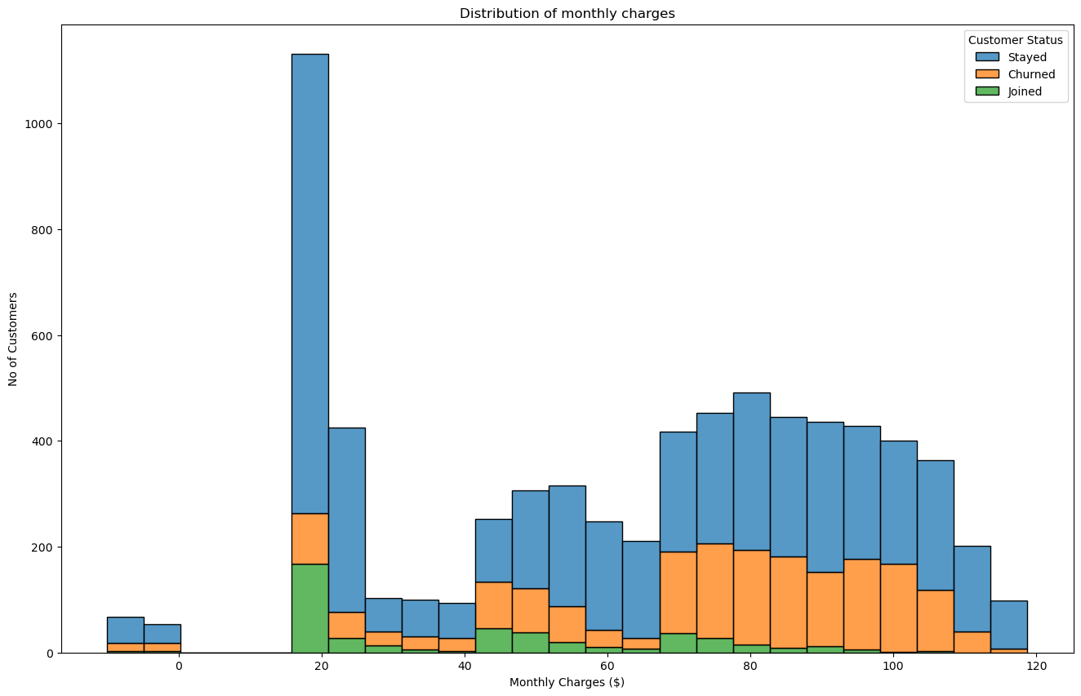
Financial Analysis
In the financial analysis, we have analysed the customer chur rate based on monthly charges.
We have used histogram to see how the distribution between the monthly charges
Average bill for a retained customer: $61.73
Average bill for a churned customer: $73.34

Slide 8
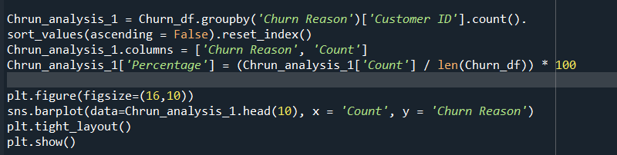
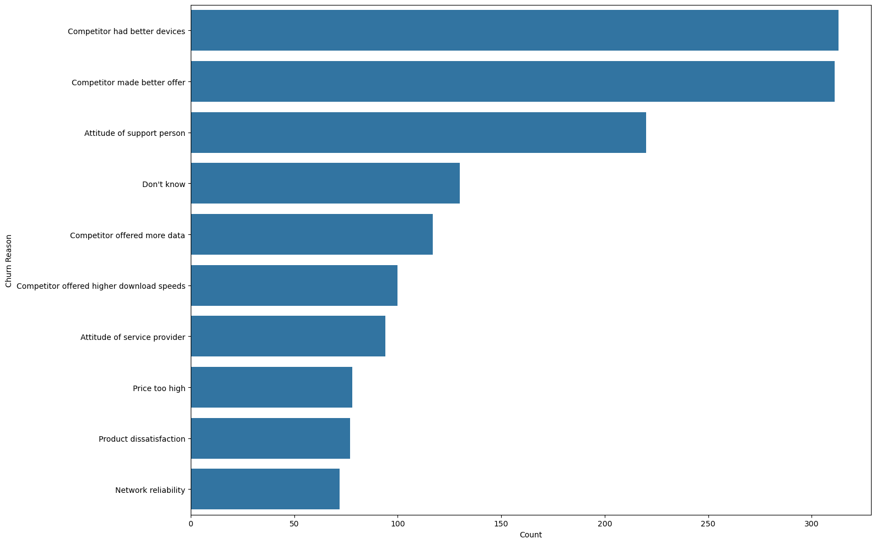
Root Cause Analysis
In the Root Cause analysis, We able see the top reasons for why customer discontinued
Competitor Threat (33%): Better devices (16.7%) and better offers (16.6%) are the top two reasons for leaving

Slide 9
THANKYOU

